Slide 1

Convolutional Neural Networks for Image Classification
Deep Learning 101
Shuang Ao
PhD student, KMi

Slide 2
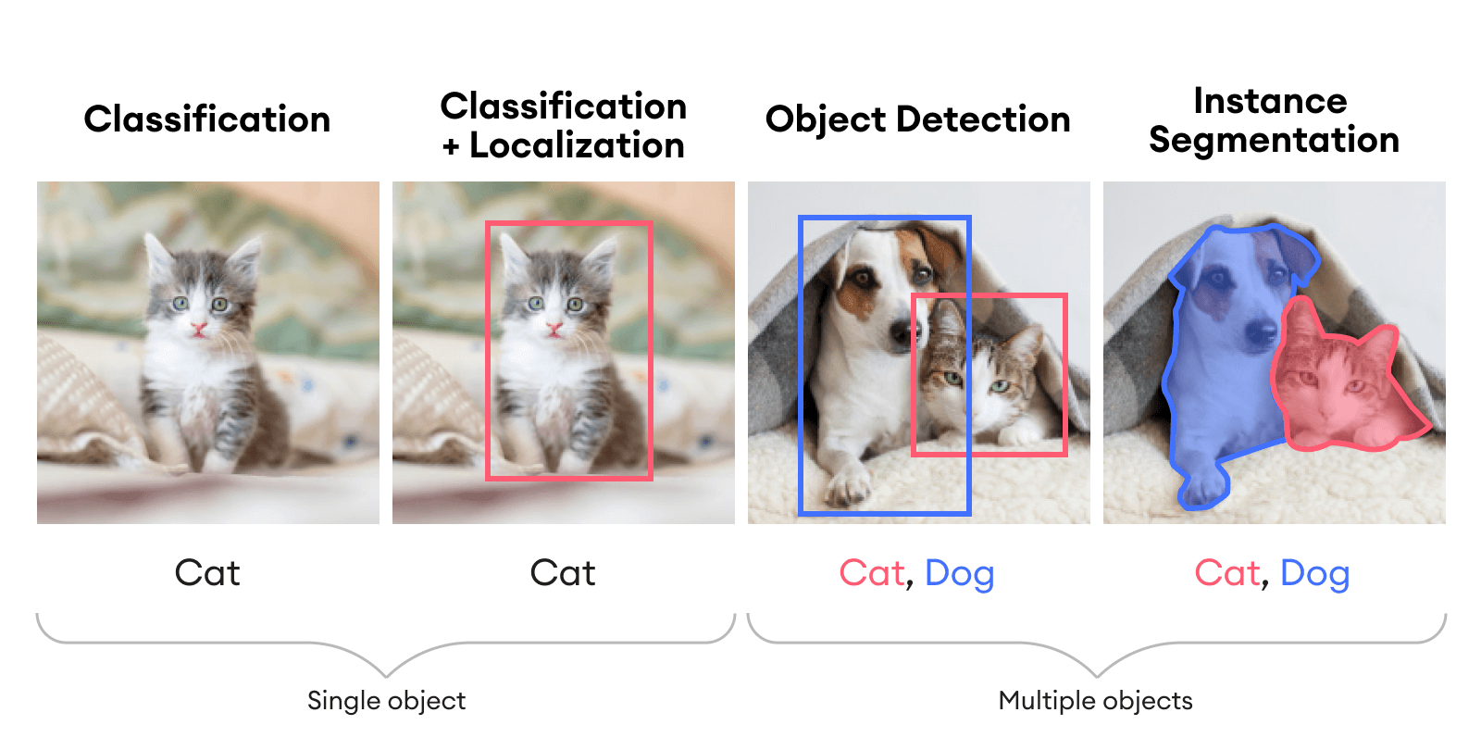
Computer Vision Tasks

Slide 3
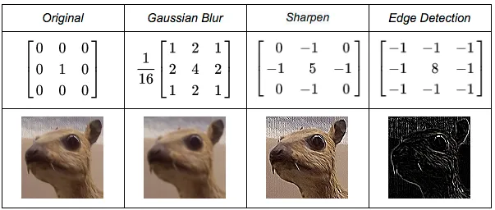
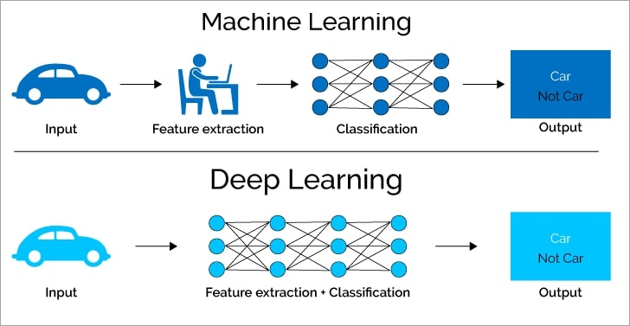
Image Classification
Filters for ML

Slide 4
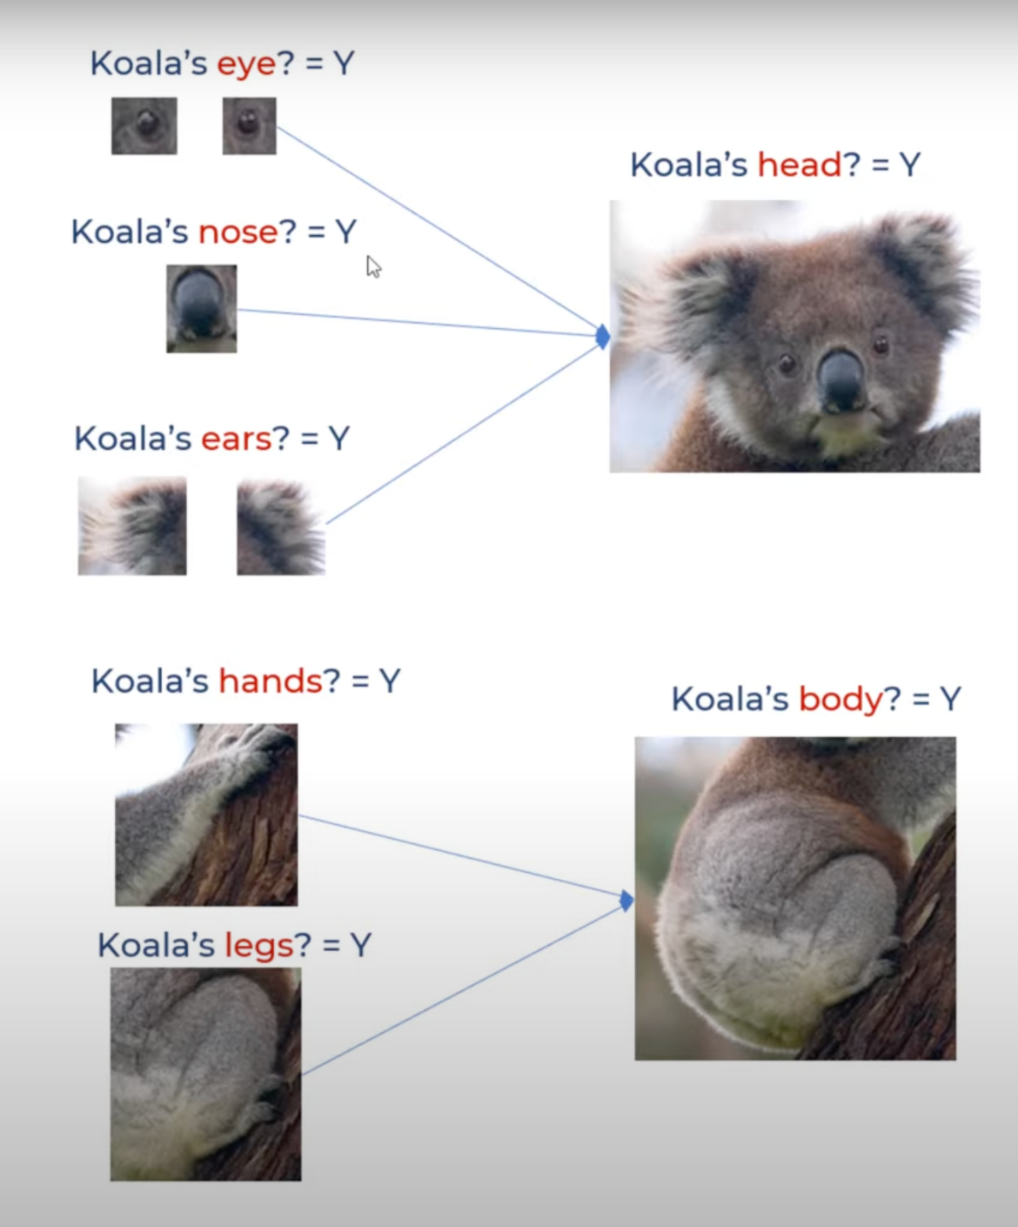
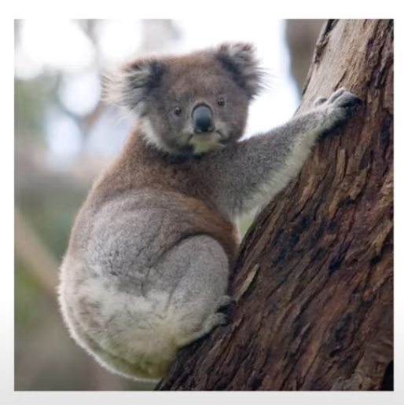
Convolutional Neural Network (CNN)
Convolution: an operation with which we can merge two arrays by multiplying them, these arrays could be of different sizes, but same dimensions.
Convolution in CNN: application of a filter to an input that results in an activation
CNN: designed for working with two-dimensional image data; automatically learn a large number of filters in parallel specific to a training dataset (in the context of a specific prediction problem such as classification)

Slide 5

CNN Model Architecture Example
CNN for exact image features:
Apply a filter to an input to create a feature map that summarizes the presence of detected features in the input.

Slide 6

CNN Model Architecture

Slide 7

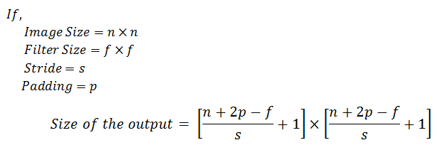
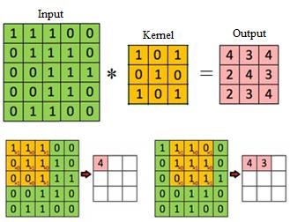
Convolution
Kernel Size: smaller than the input
Operation: multiplication applied between a filter-sized patch of the input and the filter is a dot product (results to be a scalar value)
CNN learns kernel weights

Slide 8

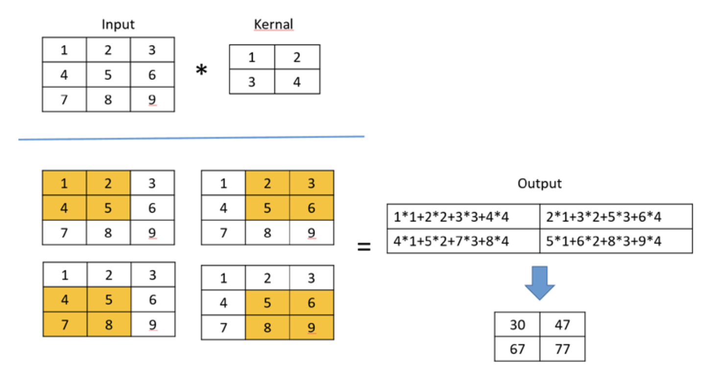
Convolution Operation

Slide 9
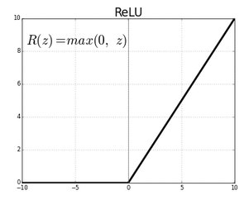
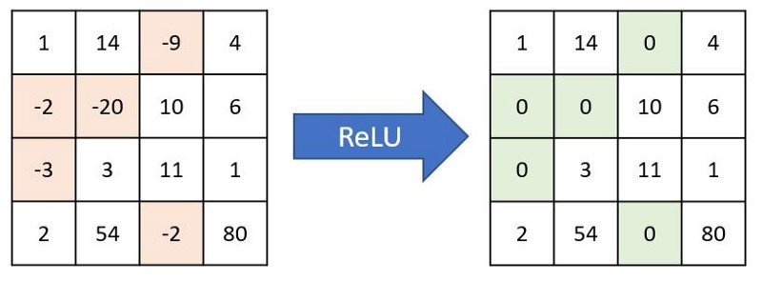
Activation function (ReLU)
Relu (Rectified Linear Unit): converts negative numbers to zeros and carry forward positive numbers.
Purpose: If a feature is not helping the network, then Relu won't carry it forward (makes it zero), else carries it forward as such.

Slide 10
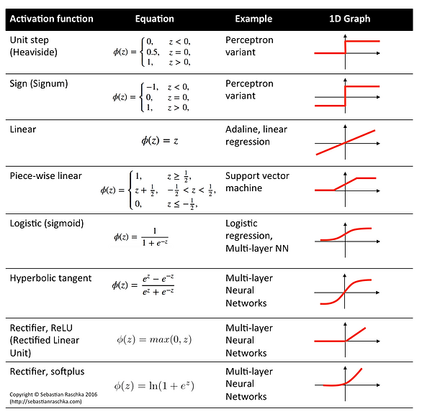
Activation function

Slide 11
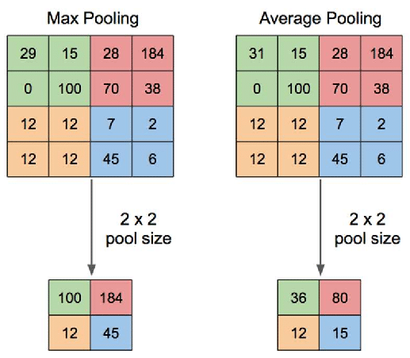
Pooling
Purpose: down sampling feature maps by summarizing the presence of features in patches of the feature map.
The size of the pooling operation is smaller than the size of the feature map; specifically, it is almost always 2×2 pixels applied with a stride of 2 pixels.

Slide 12
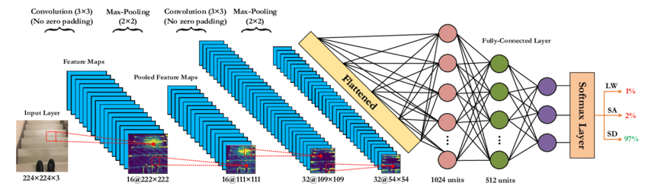
Summary of CNN Model Architecture
k=6
k=16

Slide 13
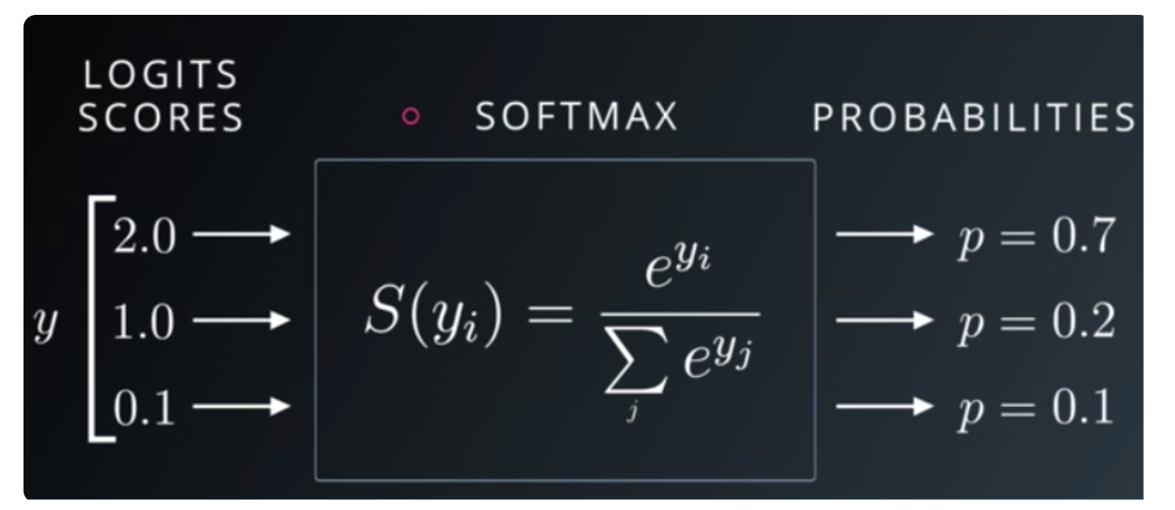
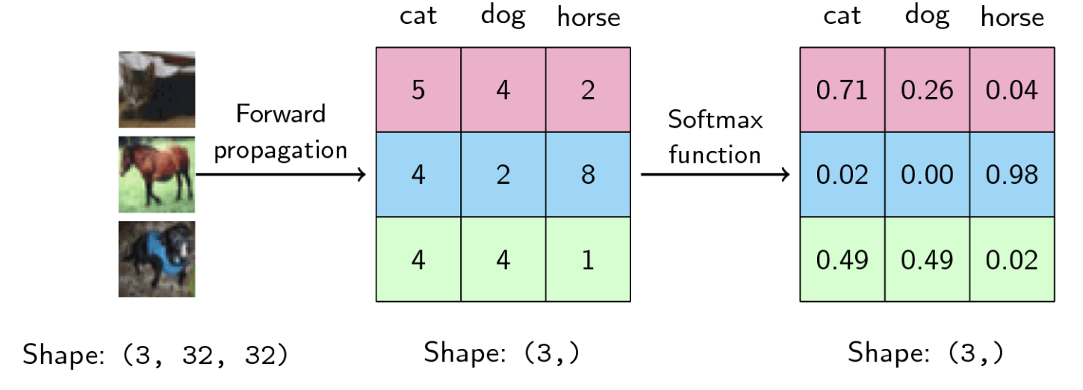
Softmax Function

Slide 14
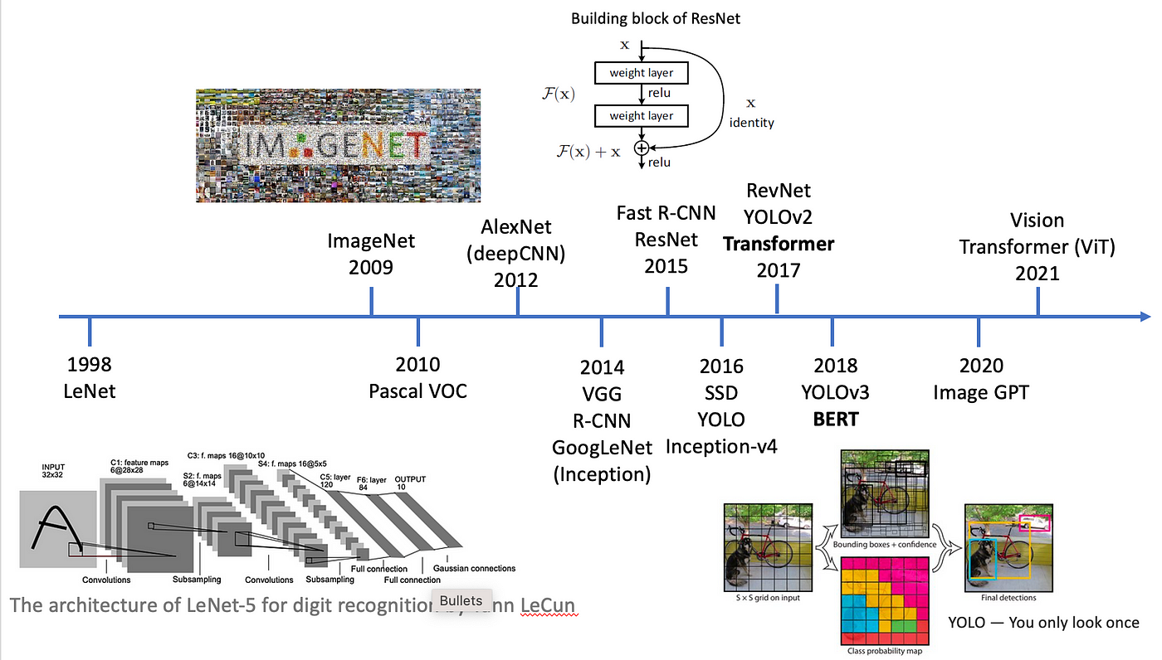
Development of DL Models with Timeline

Slide 15
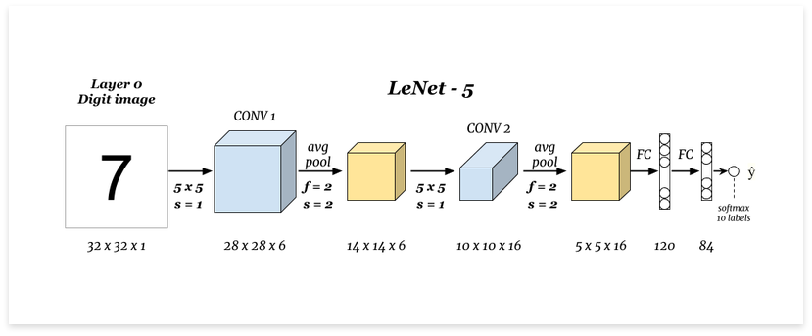
LeNet (IEEE 1998)

Slide 16
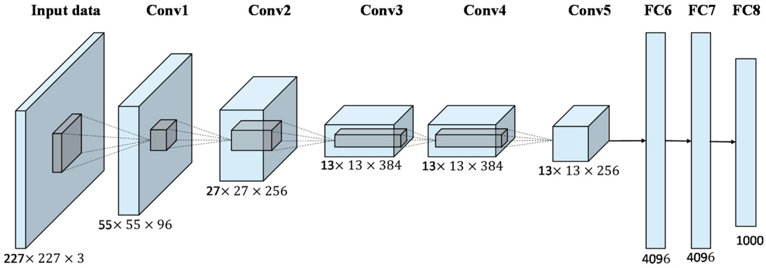
AlexNet (NIPS 2012)

Slide 17
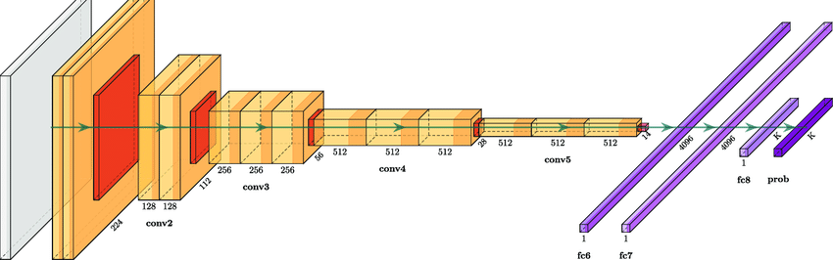
VGG (Very Deep Convolutional Networks, ICLR 2015)

Slide 18
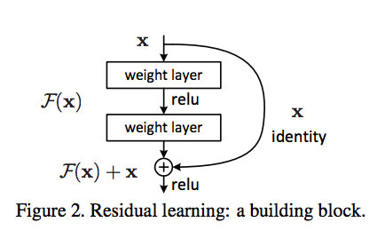
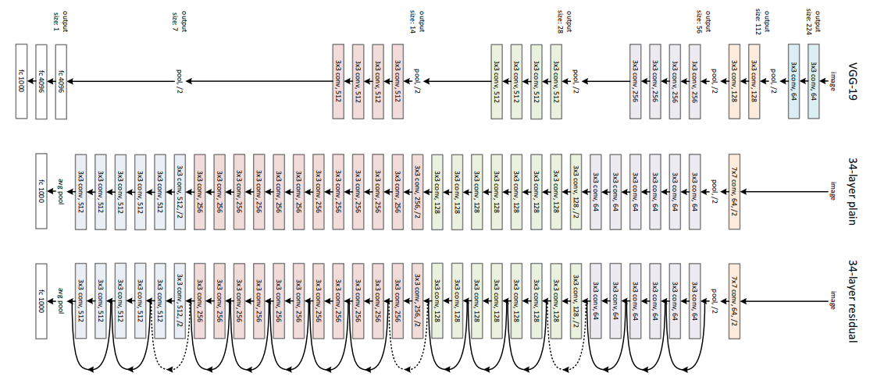
ResNet (Residual Network, CVPR 2016)
Vanishing Gradient

Slide 19
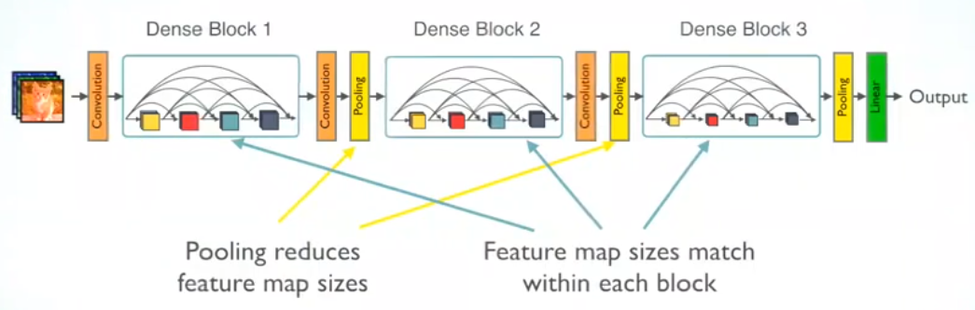
DenseNet (Densely Connected Network, CVPR, 2017)

Slide 20


Transformer (Attention is All You Need, NeurIPS 2017)

Slide 21
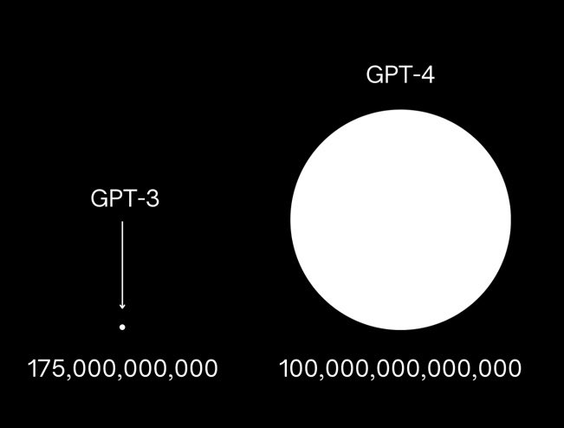
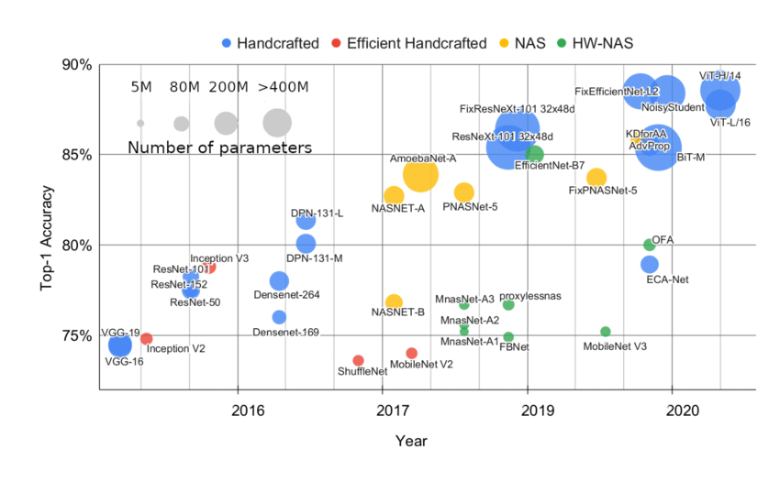
Model Parameters

Slide 22
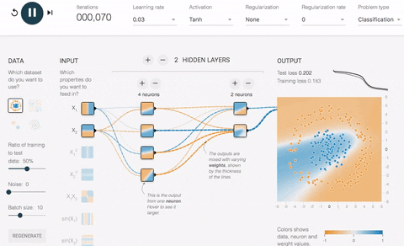

Gradient Calculation

Slide 23
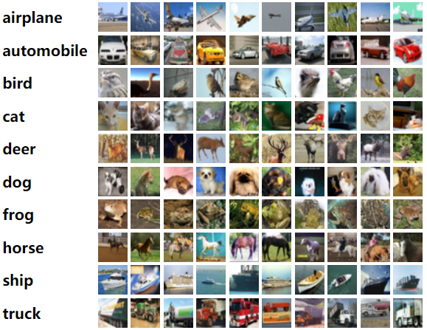
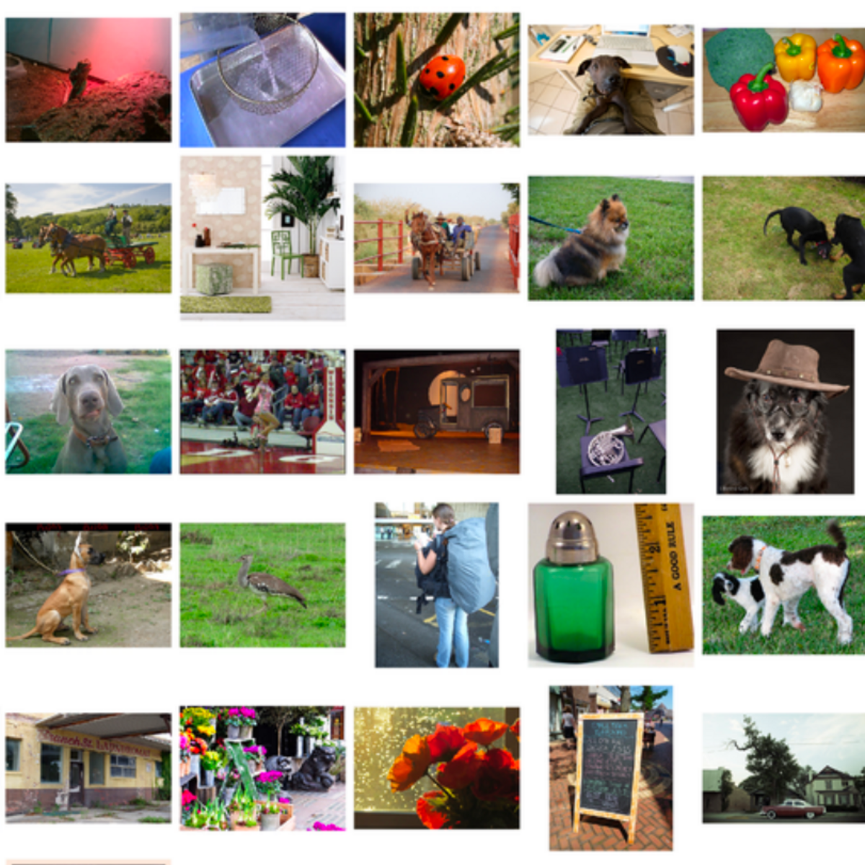
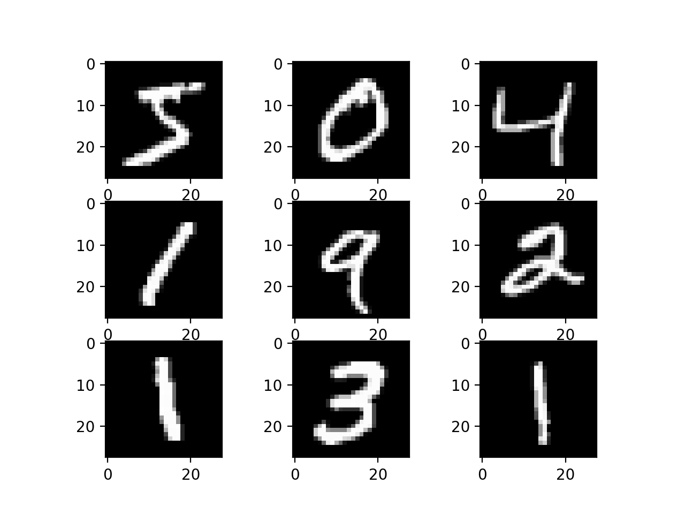
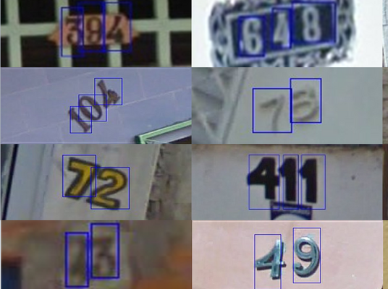
Benchmark Image Datasets
CIFAR10:
10 classes,
50,000 training,
10,000 validation
RGB: 32x32 size
ImageNet:
1000 classes,
1.28M training, 50,000 validation
RGB: 224x224 size
MNIST:
10 classes,
50,000 training,
10,000 validation,
Grey: 28x28 size
SVHN (street view house number):
10 classes,
50,000 training,
10,000 validation,
RGB: 32x32 size

Slide 24
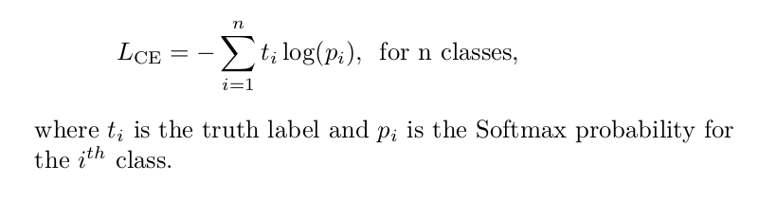
Loss Function

Slide 25
Training CNNs
Dataloader
Model Architecture
Optimizer
Loss function
Training / Validation Script

